Slide 1
Co 1 - Session 1 Quantum Mechanics: A New World for Computing
Outline:
Key principles of quantum mechanics
superposition
Entanglement
Quantum tunnelling
Quantum teleportation
Foundations of quantum computing
Fundamental challenges
Conclusion
MULTIPLE CHOICE QUESTIONS
SELF-ASSESSMENT QUESTIONS
TERMINAL QUESTIONS
References for further learning

Slide 2
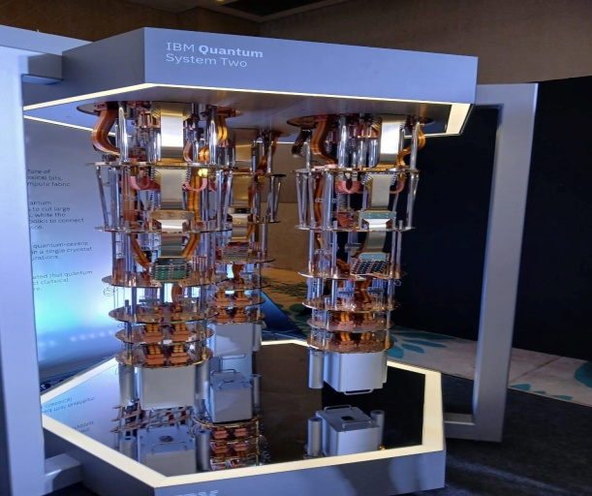
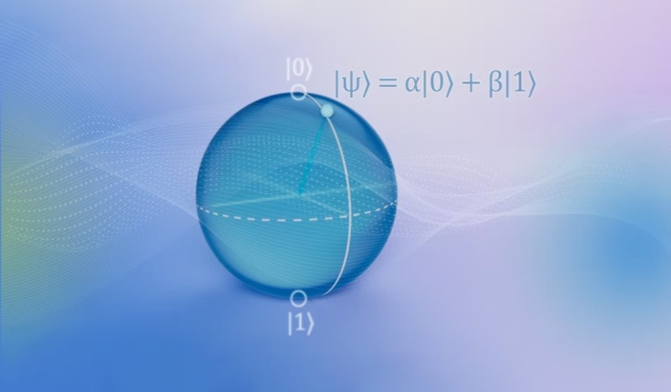
Exploring the Foundations of Quantum Computing
Quantum mechanics forms the foundation of quantum computing, which leverages quantum phenomena to perform computations in ways that classical computers cannot.
Key principles of quantum mechanics from a computing perspective:
Superposition
Definition: A quantum system can exist in multiple states simultaneously until measured. Unlike classical bits (which are either 0 or 1), quantum bits (qubits) can be in a superposition of states, represented as α∣0⟩+β∣1⟩, where α and β are complex probability amplitudes.

Slide 3
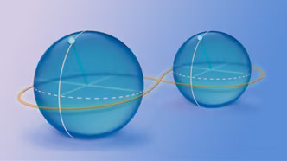
Exploring the Foundations of Quantum Computing
Role in QC: Superposition enables quantum parallelism, allowing a quantum computer to process many possibilities at once (e.g., in Shor’s algorithm for factoring large numbers).
Entanglement
Definition: When qubits become correlated such that the state of one cannot be described independently of the others, even when separated by large distances. For example, an entangled pair in the Bell state ∣00⟩+∣11⟩​ collapses to |00⟩ or |11⟩ upon measurement.
Role in QC: Entanglement is crucial for quantum communication (e.g., quantum cryptography) and algorithms like Grover’s search. It enables non-classical correlations that boost computational power.

Slide 4
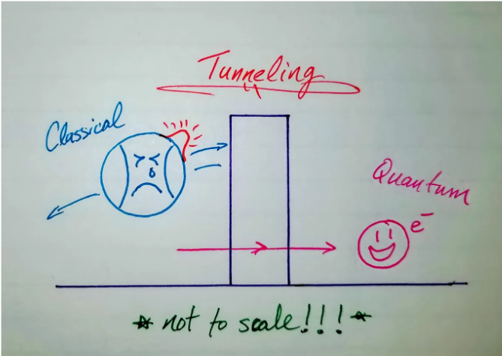
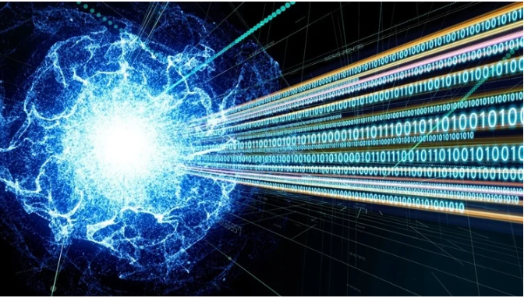
Exploring the Foundations of Quantum Computing
Quantum Tunneling
Definition: A quantum particle can pass through an energy barrier that would be insurmountable in classical physics, due to wavefunction penetration.
Role in QC: Used in quantum annealing (e.g., D-Wave systems) to find global minima in optimization problems by "tunneling" through local energy barriers.
Quantum Teleportation
Definition: A protocol to transfer the state of a qubit from one location to another using entanglement and classical communication (no physical transfer of matter).
Role in QC: Critical for quantum networks and error correction, enabling long-distance quantum communication and distributed quantum computing.

Slide 5
Exploring the Foundations of Quantum Computing
How These Principles Form the Foundation:
Parallelism: Superposition allows qubits to explore multiple solutions simultaneously.
Correlation: Entanglement links qubits in ways classical systems cannot, enabling faster information processing.
Efficiency: Tunneling and teleportation solve classically intractable problems (e.g., optimization, secure communication).
Scalability: These effects collectively overcome classical limits, offering exponential speedups for specific tasks (e.g., database search, simulation of quantum systems).
These phenomena make quantum computing uniquely powerful for certain problems, though maintaining coherence (via error correction) remains a challenge.

Slide 6
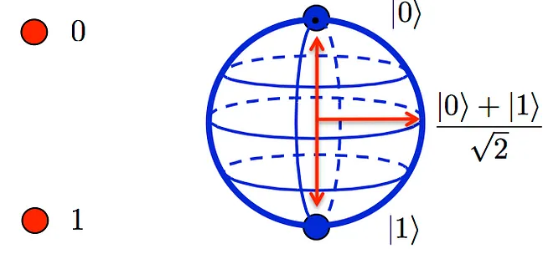
Exploring the Foundations of Quantum Computing
Quantum mechanics fundamentally challenges classical ideas of computation by introducing principles like superposition, entanglement, and quantum interference, which enable quantum computers to solve certain problems exponentially faster than classical computers.
How quantum mechanics disrupts classical computing paradigms:
Superposition vs. Classical Bits
Classical Computing: Uses bits that are either 0 or 1 at any time.
Quantum Computing: Uses qubits, which can exist in a superposition of 0 and 1 simultaneously (e.g., α∣0⟩+β∣1⟩, where α and β are probability amplitudes).
Implication: A quantum computer with n qubits can represent 2^{n} states at once, enabling massive parallelism.

Slide 7
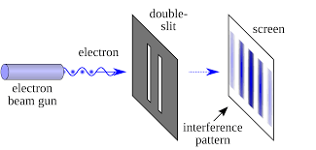
Exploring the Foundations of Quantum Computing
Entanglement vs. Classical Correlation
Classical Computing: Bits operate independently; correlations require explicit communication.
Quantum Computing: Qubits can be entangled, meaning the state of one qubit is intrinsically linked to another, even if separated by large distances (Einstein called this "spooky action at a distance").
Implication: Entanglement allows for faster information transfer and coordination between qubits, enabling algorithms like quantum teleportation and superdense coding.
Quantum Interference vs. Deterministic Logic
Classical Computing: Follows deterministic logic gates (e.g., AND, OR, NOT).

Slide 8
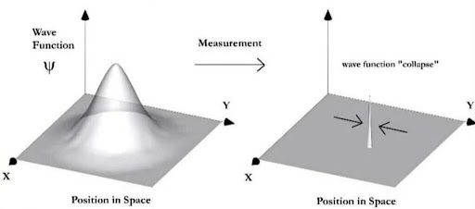
Exploring the Foundations of Quantum Computing
Quantum Computing: Uses quantum gates that manipulate probability amplitudes, allowing constructive interference (enhancing correct solutions) and destructive interference (canceling wrong paths).
Implication: Algorithms like Shor’s algorithm (factorization) and Grover’s algorithm (search) exploit interference to outperform classical counterparts.
Measurement Collapse vs. Classical Observation
Classical Computing: Reading a bit does not alter its state.
Quantum Computing: Measuring a qubit collapses its superposition into a definite state (0 or 1), governed by probabilities ∣α∣2 and β∣2.

Slide 9
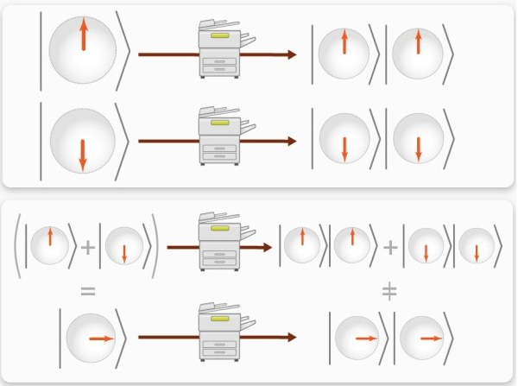
Exploring the Foundations of Quantum Computing
Implication: Quantum algorithms must be carefully designed to extract useful information before measurement destroys superposition.
No-Cloning Theorem vs. Classical Copying
Classical Computing: Bits can be copied perfectly.
Quantum Computing: The no-cloning theorem states that an unknown quantum state cannot be perfectly copied.
Implication: Quantum cryptography (e.g., quantum key distribution) leverages this for unhackable communication.
Decoherence vs. Classical Stability
Classical Computing: Bits are stable (error rates are low).

Slide 10
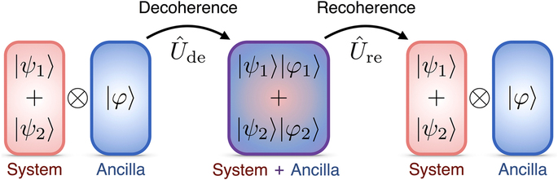
Exploring the Foundations of Quantum Computing
Quantum Computing: Qubits suffer from decoherence, where interactions with the environment destroy superposition and entanglement.
Implication: Quantum error correction (e.g., surface codes) is required to maintain computation integrity.
Why This Matters?
Exponential Speedups: Problems like integer factorization (breaking RSA encryption) and quantum simulation (chemistry, materials science) become feasible.
New Computational Models: Quantum mechanics enables non-classical approaches like adiabatic quantum computing (D-Wave) and topological quantum computing (Microsoft’s approach).
Fundamental Limits: Challenges the Extended Church-Turing Thesis, which posits that classical computers can efficiently simulate any physical process.

Slide 11
Conclusion
Quantum computing harnesses superposition, entanglement, and interference to solve problems intractable for classical computers.
However, challenges like decoherence and error correction remain active research areas. Understanding these principles is essential for developing quantum algorithms and hardware.
Quantum mechanics overturns classical computing by replacing binary logic with probabilistic, parallel, and entangled states.
While still in its early stages, quantum computing promises breakthroughs in cryptography, optimization, and scientific discovery—provided we overcome decoherence and scalability challenges.

Slide 12
Multiple choice questions
What is the state of a qubit in superposition? a) Either ∣0⟩ or ∣1⟩ b) A linear combination of ∣0⟩ and ∣1⟩ c) Always entangled with another qubit d) A classical bit with probabilistic values
Which quantum phenomenon enables "spooky action at a distance"? a) Superposition b) Entanglement c) Interference d) Decoherence
Why can’t quantum information be perfectly copied? a) Due to the No-Cloning Theorem b) Because qubits are always entangled c) Measurement collapses the state d) Quantum gates are irreversible
Which gate creates superposition from ∣0⟩? a) Pauli-X b) CNOT c) Hadamard d) Toffoli
What is the main challenge addressed by quantum error correction? a) Slow computation speed b) Decoherence and noise c) Unitary evolution d) Superposition limits
What is superposition in quantum computing? a) A qubit can only be in state |0⟩ or |1⟩. b) A qubit can exist in a combination of |0⟩ and |1⟩ simultaneously. c) A qubit loses its state when measured. d) A qubit behaves like a classical bit.
Entanglement in quantum systems means: a) Qubits operate independently of each other. b) The state of one qubit is always |0⟩ if another is |1⟩. c) Qubits are correlated such that measuring one affects the other instantly. d) Qubits can only be entangled if they are physically close.

Slide 13
Multiple choice questions
Quantum tunneling is leveraged in: a) Shor’s algorithm for factoring. b) Quantum annealing to escape local energy minima. c) Quantum teleportation protocols. d) Classical cryptography.
Quantum teleportation requires: a) Physical transfer of qubits. b) Entanglement and classical communication. c) Superposition alone. d) Large-scale quantum error correction.
Which principle enables quantum parallelism? a) Entanglement b) Superposition c) Quantum tunneling d) Decoherence What is the key difference between a classical bit and a qubit? a) A qubit can only be 0 or 1. b) A qubit can exist in a superposition of 0 and 1 simultaneously. c) A qubit is faster but less stable than a classical bit. d) A qubit cannot be measured.
Quantum entanglement allows for: a) Faster-than-light communication. b) Perfect copying of quantum states. c) Correlated behavior between qubits without direct interaction. d) Elimination of decoherence.
Which quantum principle prevents the perfect copying of an unknown quantum state? a) Superposition b) No-Cloning Theorem c) Quantum Interference d) Decoherence
In quantum computing, measurement of a qubit results in: a) The qubit remaining in superposition. b) The qubit collapsing to a definite state (0 or 1). c) The creation of two entangled qubits. d) The reversal of quantum gates.
Which algorithm demonstrates exponential speedup over classical methods for integer factorization? a) Grover’s algorithm b) Shor’s algorithm c) Deutsch-Jozsa algorithm d) Quantum Fourier Transform

Slide 14
Self-assessment questions
Explain how superposition enables parallelism in quantum algorithms like Grover’s search.
Describe the difference between classical and quantum entanglement in your own words.
Why must quantum gates be reversible? Give an example of a reversible gate.
How does destructive interference help in quantum algorithms?
What happens to a qubit’s state after measurement? Why is this irreversible?
Explain how superposition differs from classical bit states.
Describe a scenario where entanglement is essential for a quantum algorithm.
Why is quantum tunneling useful in optimization problems?
How does quantum teleportation avoid the "no-cloning" theorem?
What are the practical challenges in maintaining quantum coherence?
Explain how superposition enables quantum parallelism.
Why is entanglement crucial for quantum communication protocols like teleportation?
Describe how constructive and destructive interference are used in quantum algorithms.
What is decoherence, and why is it a major challenge for quantum computers?
How does the no-cloning theorem enhance quantum cryptography?

Slide 15
terminal questions
Compare and contrast classical bits and qubits, highlighting how superposition and measurement affect computational outcomes.
Analyze the role of entanglement in quantum teleportation. Include a diagram of the quantum circuit if possible.
Derive the final state of two qubits after applying a Hadamard gate to the first qubit followed by a CNOT gate (assume initial state ∣00⟩).
Evaluate the implications of the No-Cloning Theorem for quantum error correction.
Design a simple quantum circuit (using H, X, CNOT) to create a Bell state and explain each step.
Compare and contrast the roles of superposition and entanglement in Shor’s algorithm versus Grover’s algorithm.
Critically evaluate the statement: "Quantum tunneling makes quantum annealing superior to classical optimization methods."
Design a high-level protocol for quantum key distribution (QKD) using entanglement, highlighting security advantages.
Discuss how quantum teleportation could enable scalable quantum networks.
Compare and contrast classical logic gates (AND, OR) with quantum gates (Hadamard, CNOT). How do quantum gates exploit superposition and entanglement?
Explain the role of quantum error correction in fault-tolerant quantum computing. Why is it harder than classical error correction?

Slide 16
References for further learning
Books:
Quantum Computation and Quantum Information by Nielsen & Chuang (standard textbook).
Quantum Computing for Everyone by Chris Bernhardt (beginner-friendly).
Papers:
Original Shor’s and Grover’s algorithm publications.
Online:
Qiskit (IBM) and Cirq (Google) for hands-on quantum programming.

